Slide 1




SolarSense AI
Agentic Solar Installation Advisor
"Making solar adoption logical, mathematically calculated, and transparent."
EVALUATED BY
SYSTEM STACK
Project Review Panel
Autonomous n8n Workflow
AI
Slide 1 of 10 • Academic Evaluation Deck

Slide 2

Rooftop Solar Adoption Barriers
Homeowners globally express high structural interest in transition, but face information hurdles.
Missing Sizing Rules: Determining structural and electrical capacity requires engineering calculation variables.
Academic Case Insight
Analysis shows over 78% of prospective residential clean-energy customers exit the transaction pipeline due to analytical decision paralysis.
Incomplete ROI Models: Dynamic tracking of utility tariffs, installation costs, and localized subsidies is obscure.
Trust Gap: Difficulty finding vetted, regional system installation providers.
Slow Analog Sales Cycles: Traditional consultation pipelines require 2–3 weeks of on-site vendor inspection.
AI
Slide 2 of 10 • Problem Definition

Slide 3
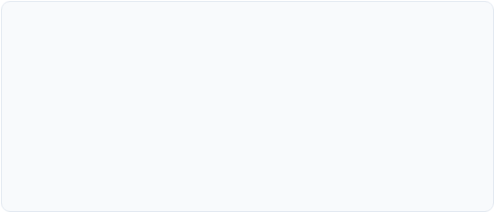

A True Agentic AI Solution
This architecture doesn't just conversationalize; it executes complex, automated structural logic on behalf of the customer.
Platform Tech Stack
Active Data Ingestion: Collects 5 key operational metrics from the user.
Logical Calculation: Runs algorithms instead of estimating ranges or hallucinating.
ENGINE
LLM REASONING
Document Compiler: Dynamically compiles and generates formal PDF report payloads.
REGISTRY CRM
AUTOMATION
Relational DB Mapping: Interrogates location tables to map certified installers based on PIN code.
AI
Slide 3 of 10 • Technical Philosophy

Slide 4

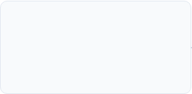
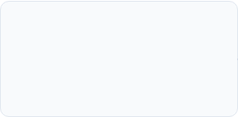
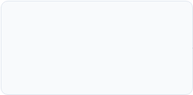

Autonomous Workflow Execution Pipeline
The Agent steps systematically through validation, mathematical evaluation, localized vendor compilation, and document distribution.
Validate Inputs
Compute Capacity
Feasibility Model
Fulfillment
Parse Name, Email, PIN, Roof Area, and Bill metrics.
Estimate required kW sizing and panel counts.
Compare space demands against physical roof constraints.
Map local vendors, construct PDF, and email report.
Execution Metric: The entire workflow loop executes from ingestion trigger to email delivery in less than 4 seconds.
AI
Slide 4 of 10 • Workflow Pipeline

Slide 5




Double-Gate Feasibility Check Engine
To secure user trust, recommendations must be geographically and architecturally realistic.
BILL SIZING DEMANDS
ROOF MAX SPACE
The Agent runs a conditional algorithm that evaluates whether the space indicated can physically support the capacity necessary to zero-out their utility statement.
5.0 kW
3.2 kW
Based on ₹ monthly utility bill inputs.
Based on entered roof sq.ft.
AGENT OPTIMIZATION LOGIC
AI Action Plan:
"Required Capacity > Maximum Installable: Recommend physical constraint limit system (downscale safely) and suggest mounting designs."
AI
Slide 5 of 10 • Feasibility Sizing Logic

Slide 6

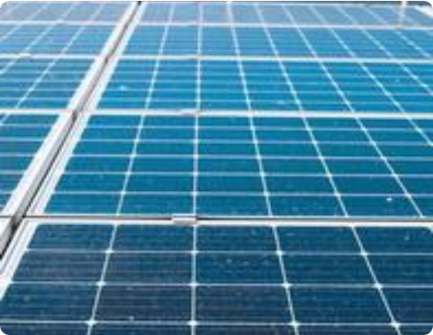
Analytical Model: Financial & Carbon Yield
The system uses structural estimation factors to calculate yield:
System Cost Model: Approximate pricing scale based on computed kW size, calculating modular frame and hardware installation.
Yield Forecasting: Computes monthly & yearly savings curves using average power tariffs.
Investigative ROI: Returns a practical estimate of the system payback timeline (years to break even).
Carbon Equivalent: Standardizes calculated offset into metrics of CO₂ tons reduced annually.
AI
Slide 6 of 10 • Computational Sizing Models

Slide 7

System Execution Framework Comparison
Analyzing the operational efficiencies of agentic loops against archaic process systems.
Operations Metric | Traditional Consultation | Legacy Static Calculators | SolarSense Agent
Response Duration | 14 - 21 Days | Instantaneous | < 4 Seconds
Calculated Feasibility Check | Manual tape evaluation | Not available / None | Automated conditional logic
Vendor Match Curation | Unstructured brokers | Broad, non-local advertising | Local PIN database query mapping
Report Generation & Delivery | None / Manual PDF | None / Simple screen math | Automated HTML to PDF email pipeline
AI
Slide 7 of 10 • Structural Metrics Table

Slide 8
Feature Curation Comparison
Positioning comparative feature categories to show operational coverage across the ecosystem lifecycle.
Evaluation Segment | Basic Web Calculator | Lead Brokers | Chatbots (LLM only) | SolarSense AI
Logical Capacity Assessment
Automated Feasibility Check
Geographical PIN-to-Vendor Mapping
Document Compilation & Delivery
AI
Slide 8 of 10 • Feature Matrix

Slide 9
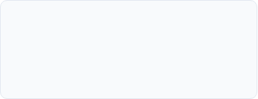
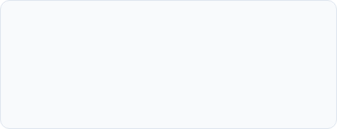
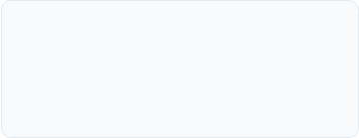
Scalable Monetization Framework
Verified Lead Fees
Vendor Commissions
Enterprise API Licensing
Installers pay recurring platform subscription or single referral fees for pre-qualified customer leads with validated requirements.
Standardized success fees collected upon transaction settlement with certified installers on our registry.
White-labeled logic integrations for retail mortgage providers, green-financing channels, and real estate discovery portals.
Value Proposition: Each user interaction compiles unique geographic, physical, and financial telemetry data, creating continuous monetization opportunities.
AI
Slide 9 of 10 • Platform Monetization

Slide 10
github link : krushnads25/SolarSense-AI

